Slide 1
Smart Sound Switch

Slide 2
Problem Statement
We tend to ignore or forget a basic mobile etiquette to keep the mobile phones in silent mode at places like temples, churches, mosques, public meetings (assembly, parliament), hospitals, funeral grounds, theatres, your workplace, schools, colleges.., which sometimes put us in awkward situations.

Slide 3
Solution
Automated sound mode switching based on locations (POIs)
Location selection
Specific POIs
work – Calendar integration
Favourite POIs
All POIs (temples, hospitals, educational institutions etc)

Slide 4
Special points taken care
Selective inclusion/exclusions
Forced sound mode resetting when multiple calls from favourites

Slide 5
Intelligence
When GPS signal is stable for a specific time at the defined POI categories, the sound switches to the set mode
Interactive calendar
Alerting the event details along with the estimated time to attend the event based on user’s location.
Any event scheduled with conference calls will be dialled and connected upon approval

Slide 6
Target Audience
White collar employees
Medical practitioners
Lawyers
MLA’s/MP’s (at least during assembly or parliament sessions)
Students
Anyone who doesn’t want to embarrass themselves and cause disturbance with their loud ringtones

Slide 7
V1 vs V2
Automated sound mode switching based location
Interactive calendar
event based conference call connectivity

Slide 8
Technology stack
Platform – Android
IDE – Android studio
APIs – Google places
Database - SQLite

Slide 9
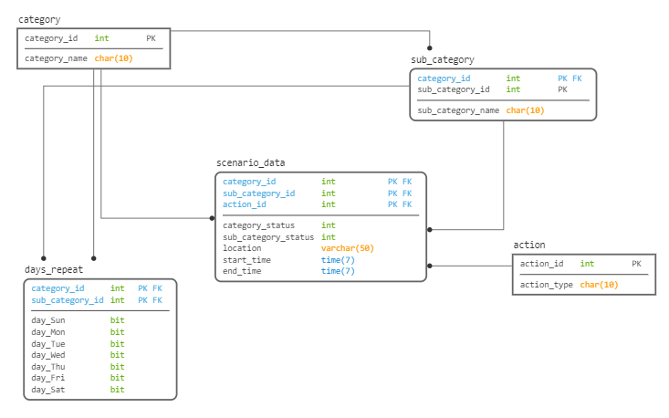
Database schema

Slide 10
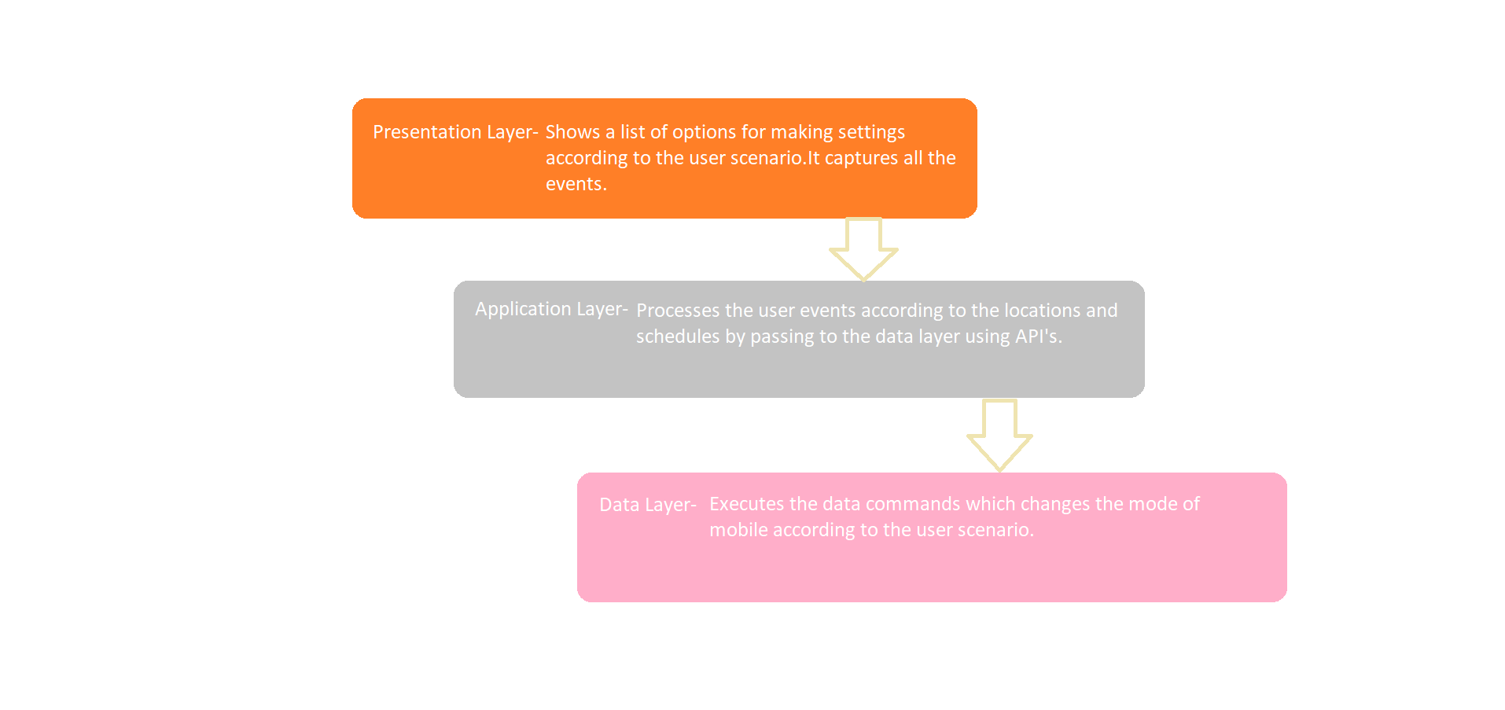
Architecture spec

Slide 11
Competitors
Mute by Location -This app allows you to set the volume of your ringtone/vibration alarm based on locations you set on the map.
Location Silence -Location Silence is a lightweight app which provides the functionality to set the volume of your device at specific locations. Draw shapes where you would like to set the device volume to Mute/Vibrate/Quiet/Loud.
Silent on Location-Choose locations where you want to silent your phone. This app will automatically detect when you enter that place and change your ringer settings to silent mode. It also detects as soon as you leave that place and again changes your ringer settings to normal.
Mute me-Mute Me allows you to set your phone to automatically mute and un-mute when you need some quiet time. You can create multiple profiles that can start on one day and finish the next, set the days to repeat and let Mute Me do the rest.

